Slide 1
React and Redux: Lesson 2
JSX, State, Lifecycle methods
William Abboud
* Covers React v15 - 16

Slide 2

JSX Deep Dive
XML-like syntax to create UI elements
Compiles down to React.createElement() functions
Needs React in scope
Capitalize custom components
Pass JS expressions in props
Pass strings into props directly
Booleans attributes default to true
Spread attributes
Children
Comments
Notes:
We begin by deep diving into JSX by going through each point and explaining it with an example

Slide 3
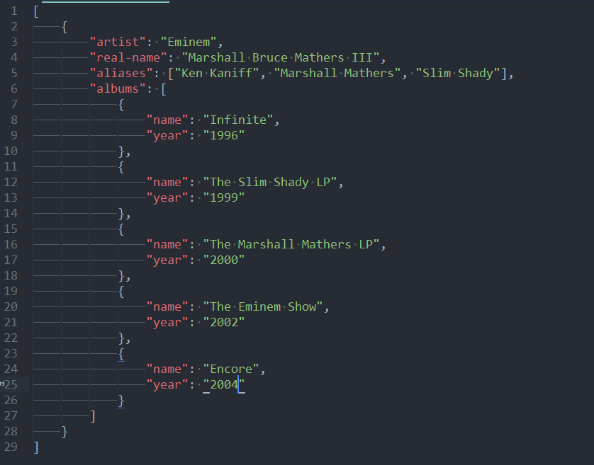
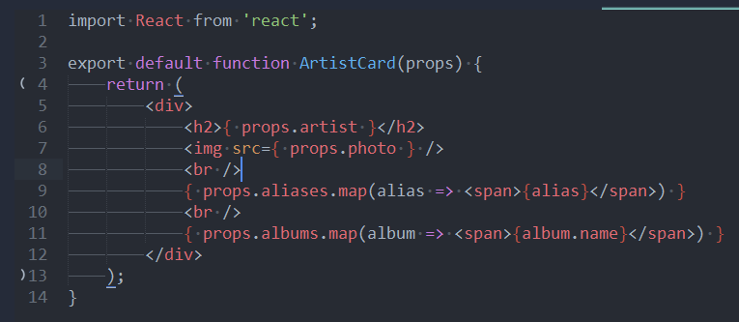
Displaying JSON data
Notes:
Talk about purity in render function
Talk about how in most cases you will have components rendering JSON data
Talk about rendering arrays
Talk about passing props ways
Demo

Slide 4
PropTypes
Used for documentation
Evaluates props runtime
Can remove the need to use typeof operator
Can be used as API documentation
https://reactjs.org/docs/typechecking-with-proptypes.html
Notes:
PropTypes mimic what typed variables do in languages like Java, C# etc.
They are evaluated runtime
Their real purpose is documentation
Talk about Default Props
Talk about keys and a little bit about the diffing algorithm

Slide 5
Composition
Composition offers the ability to create hierarchies of components
Increases reusability
Easy to test
Easy to isolate bugs or errors
Notes:
Composition is the preferred pattern when building React applications
With composition it easy to eliminate errors

Slide 6

State
Notes:
Introduction to state
Stateless components vs state components
Render() method is not optional
State is just an object
Declarative vs Imperative

Slide 7


ES6 Classes and React
Notes:
Talk about how ES6 classes tie into React

Slide 8

Component Lifecycle
Photo by Sebastian Spindler on Unsplash
Notes:
React lifecycle methods are methods React will call on your behalf at specific points in the life of a component
There are 3 stages: Initialization, Update and Unmounting and each stage covers a period of the life of your Component
There react lifecycle methods are heavily utilized but you need not remember their specific order in my opinion

Slide 9
Initialization phase
GetDefaultProps - called only once to return default props
GetInitialState - called only once to return an initial state object
ComponentWillMount - called before render, useless
Render - returns your markup for rendering, has to be pure
ComponentDidMount - called last, most frequently used to do AJAX calls, and interacting with the DOM
Notes:
For React to correctly call your lifecycle methods you need to type them correctly, React is case sensitive and explicitly requires the names to be correct
Shows initialization phase and the order of all the lifecycle methods that fire
GetDefaultProps is a method which returns a “props” object which will be merge with the actual passed props
GetInitialState is a method removed in ES6 classes but it’s a part of the initialization phase of the props
Render - markup is composed from React.createElement() calls and you can use props and state values, DO NOT call setState
ComponentWillMount is basically useless in my opinion and I never ever had a use case for it in production
ComponentDidMount - initial markup is on the screen, best to to AJAX data load, can call setState, can interact with DOM

Slide 10
Update phase - Props
ComponentWillReceiveProps - used to set state based on upcoming props
ShouldComponentUpdate - determines renders on props/state update
ComponentWillUpdate - used to prepare for update (no setState) almost useless
ComponentDidUpdate - basically just like componentDidMount but for after update widely used to change the DOM
Notes:
componentWillReceiveProps(nextProps) - called when props have changed, used to update state without rerendering
shouldComponentUpdate(nextProps, nextState) - Controls where your component will re render
componentWillUpdate(nextProps, nextState) - used to prepare for update, called as soon as shouldComponentUpdate returns true DO NOT call set state
componentDidUpdate(prevProps, prevState) - used to update the DOM

Slide 11
Update phase - State
ShouldComponentUpdate - determines renders on props/state update
ComponentWillUpdate - used to prepare for update (no setState) almost useless
ComponentDidUpdate - basically just like componentDidMount but for after update widely used to change the DOM
Notes:
shouldComponentUpdate(nextProps, nextState) - Controls where your component will re render
componentWillUpdate(nextProps, nextState) - used to prepare for update, called as soon as shouldComponentUpdate returns true DO NOT call set state
componentDidUpdate(prevProps, prevState) - used to update the DOM

Slide 12
Unmounting
ComponentWillUnmount - called before the component is removed from the DOM, used to clear out any side effects such as leftover timeouts, event listeners etc.
Notes:
componentWillUnmount - used to clear our timeouts, remove event listeners etc.

